Slide 1
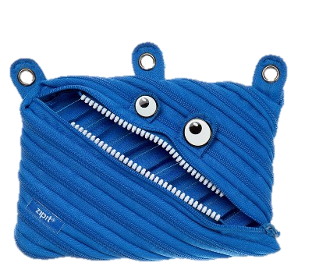
Project Zippables
Almog & Leon
with the guidance of Dr. Roi Poranne

Slide 2
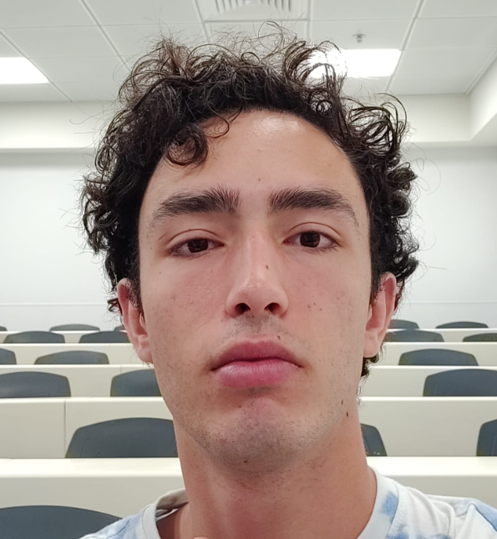
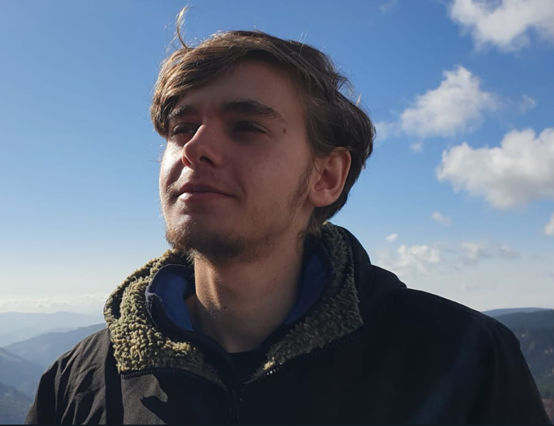
About us
Almog Ben Chen
Leon Gurin
ID number: 214715070
Email: almogush7@gmail.com
ID number: 214511214
Email: leon9gur@gmail.com

Slide 3
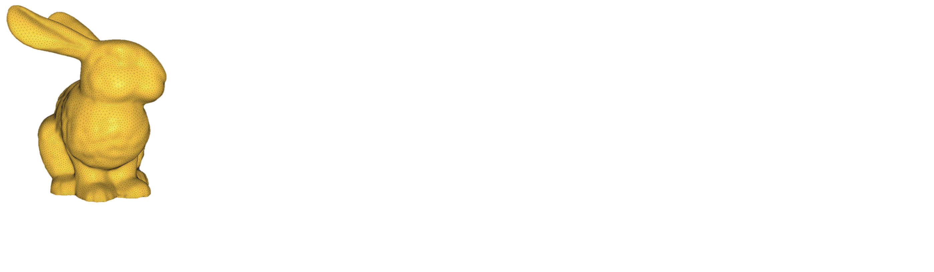
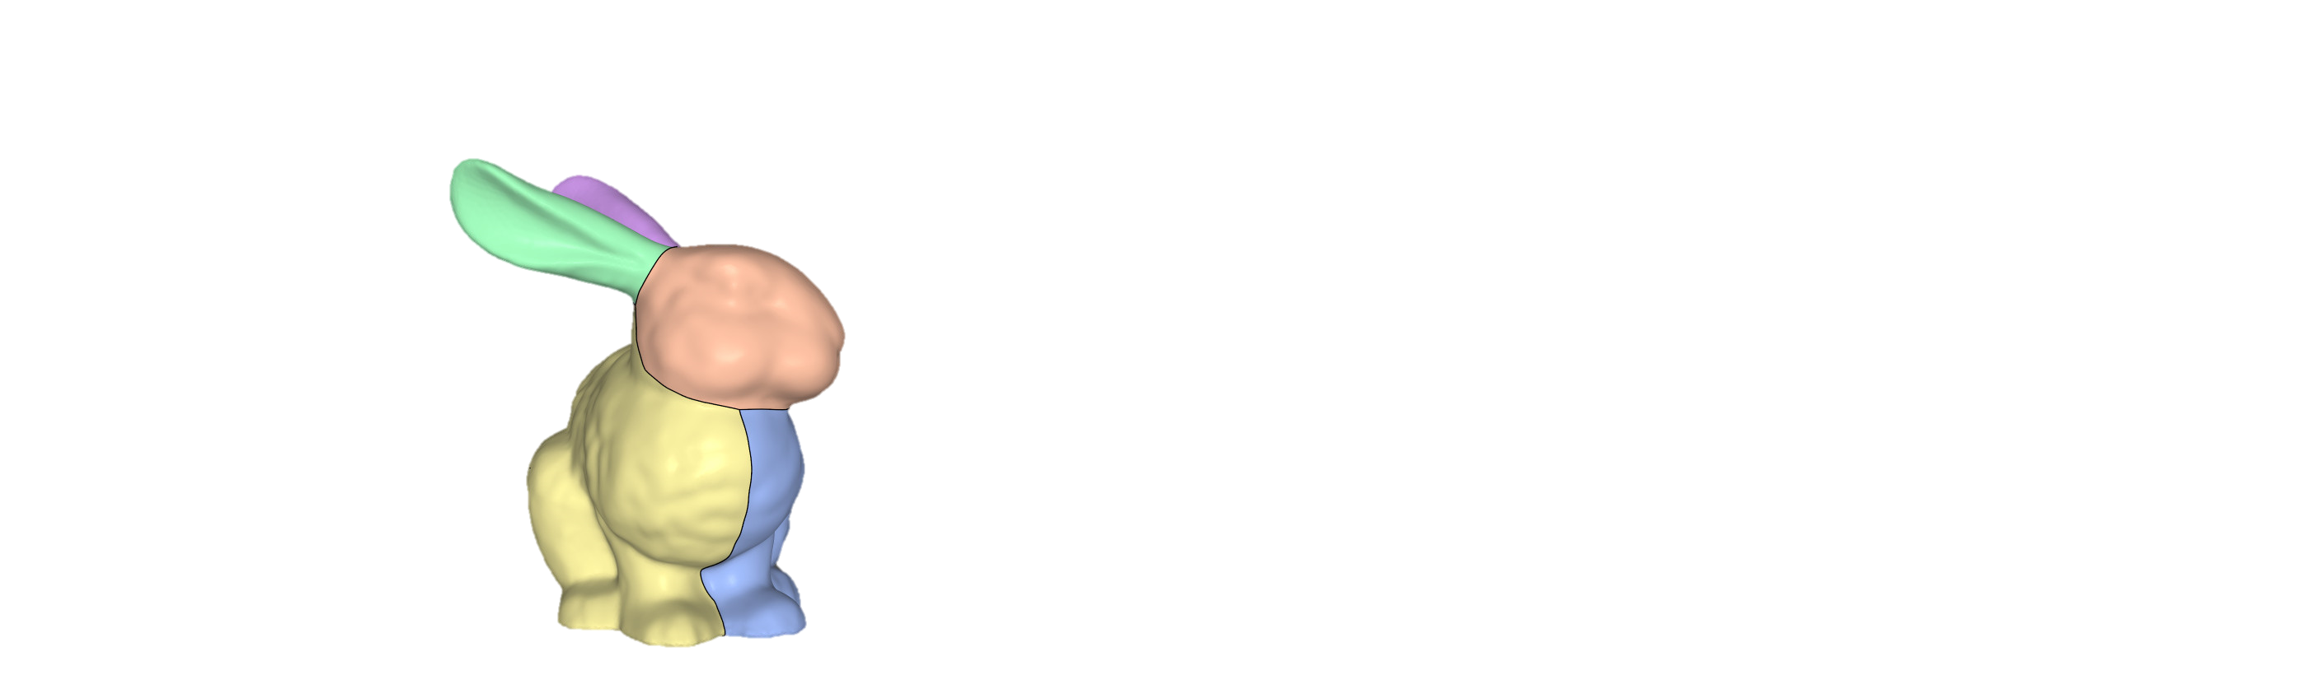



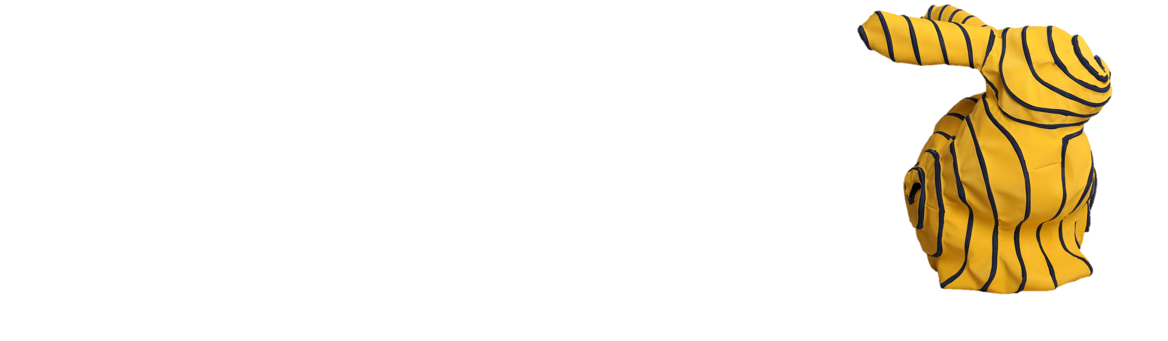
Project Idea
Our project is based on our advisor’s work in the following paper: https://people.inf.ethz.ch/poranner/papers/zippables/zippables.pdf
The idea behind this project is to develop an algorithm which turns any 3D object into a “zippable”
Notes:
Remember to say that our final goal is to migrate the code to a sewing machine, go over problems with current implementation.

Slide 4



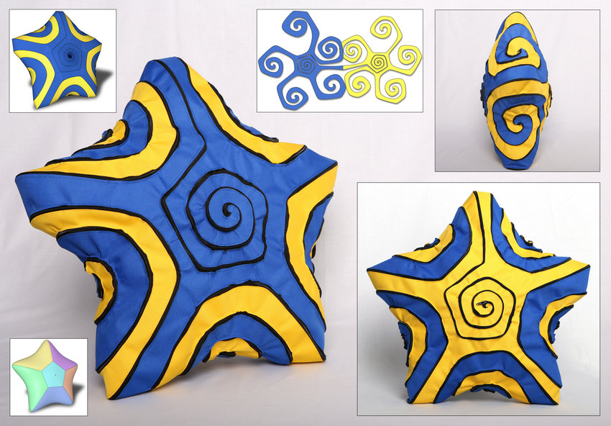


Project Goals
Understand Fabrication Algorithms
Learn and apply relevant algorithms – segmentation, single spiraling curve
Improve the current implementation
Reformat the current codebase, learn to use igl, eigen
Interact with knitting machine
Study the relevant software to interact with a knitting machine
Convert the results to the sewing-machine API
Create automatic algorithm for large-scale 3D knitting
Create knitted zippables
3m Stanford bunny!

Slide 5
Timeline
Dec 2022
Review past work
And begin code
refactor
Mar 2023
Implement minor
Functionalities
In knitting machine code
Jul 2023
Troubleshooting and debugging
Hopefully big Stanford bunny!
Jan 2023
Finish refactor
Begin studying
knitting API
May 2023
Implement novel algorithms in knitting code

Slide 6
Thank you
Here is our Github project repository:
https://github.com/LeonGurin/University-of-Haifa-Final-Project/blob/main/README.md

